Slide 1
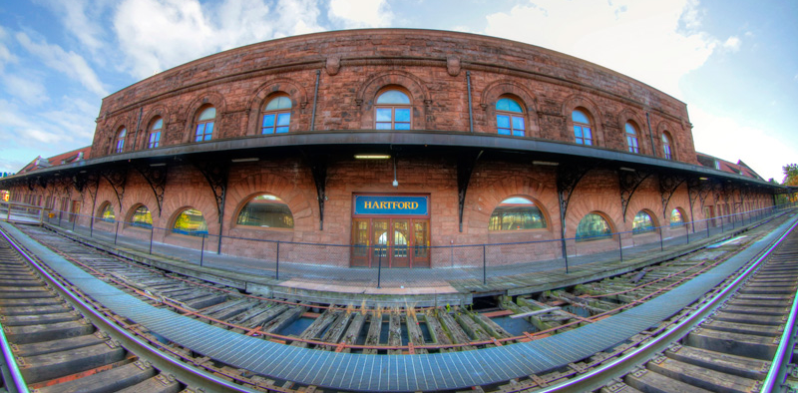

Greater Hartford Transit District
Disadvantaged Business Enterprise (DBE)
Triennial Goal Development and Contracting Opportunities
2026-2028
Encouraging DBE Contractor Participation in GHTD Projects

Slide 2
The Purpose of the DBE Program and Goal
The proposed Disadvantaged Business Enterprise (DBE) goal detailed in this presentation has been prepared to ensure nondiscrimination in the award and administration of Department of Transportation (U.S. DOT) assisted contracts. More specifically, in the Federal Transit Administration’s (FTA) transit programs. It is prepared to create a level playing field on which DBEs can compete fairly for U.S. DOT-assisted contracts. (Code of Federal Regulations, Section 49, Part 26)
GHTD is the recipient of funding from the FTA and, as part of its ongoing Civil Rights efforts, has prepared this goal which is a reflection of the potential DBE participation in a variety upcoming federally funding projects.
Disadvantaged Business Enterprises (DBEs) are for-profit small businesses where socially and economically disadvantaged individuals own at least a 51% interest and also control management and daily business operations — owners can be minorities, women, or people with disabilities. GHTD sets triennial goals to procure services and goods through partnerships with DBEs.

Slide 3
Objectives of the GHTD DBE Program and Goal
GHTD’s DBE Program Aims To:
Prevent discrimination in U.S. DOT- assisted (funded) contracts;
Work toward a level playing field for DBEs;
Remove barriers to DBE participation;
Promote the use of DBEs; and
Develop firms to successfully compete for GHTD contracts.
FTA provides flexibility to recipients in developing their DBE program.

Slide 4
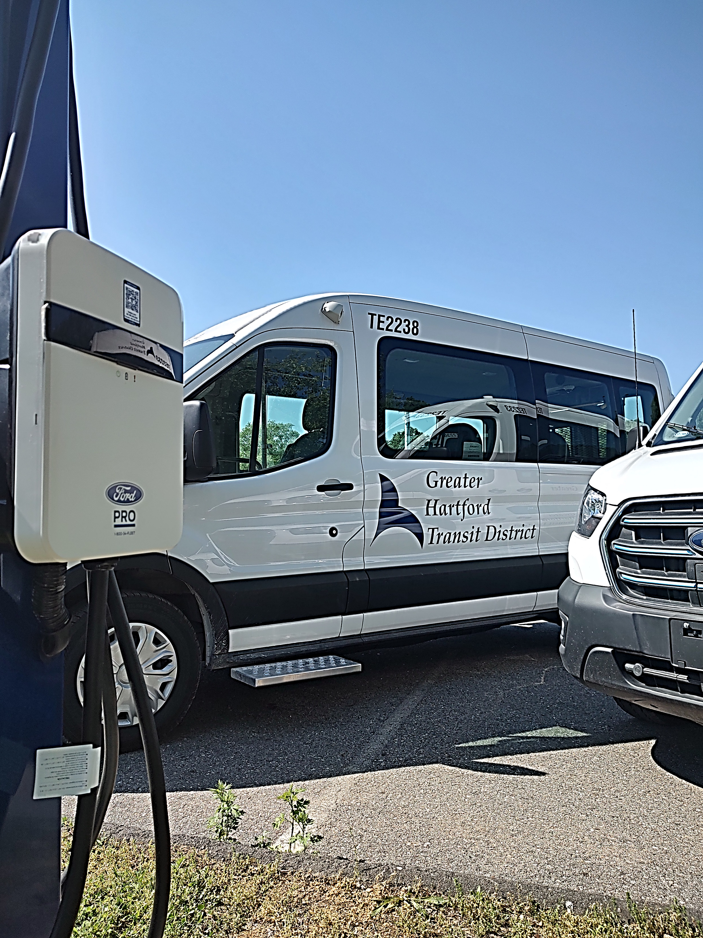
About Greater Hartford Transit District
GHTD administers a variety of programs related to public transportation in Connecticut. While these change from time to time, the agency’s current projects include:
The provision of transportation services under the American’s with Disabilities Act (ADA) in Connecticut’s Capital Region;
The operations of a regional transportation service known as the Encompass Program which also provides regional mobility services for riders with disabilities and seniors in the Capital Region;
The management of a Taxi voucher program for ADA eligible riders known as Freedom Ride, which permits riders to travel beyond the current ADA service area and service span;
The operation of a pilot Microtransit service known as GHTD Link, providing door-to-door service for residents in select areas of Enfield and East Windsor.

Slide 5
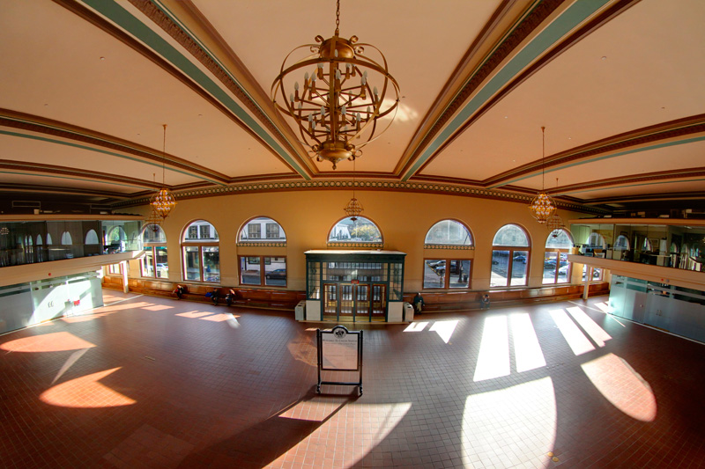
About Greater Hartford Transit District
Union Station – One Union Place, Hartford
GHTD owns and operates Hartford’s Union Station.
A three-acre campus includes historic Union Station, which is host to a number of office tenants and a number of public transit providers including Amtrak, Peter Pan, and Greyhound Interstate Bus Service, CTTransit, CT Rail (The Hartford Line),
The campus also includes the Spruce Street Parking lot – a 170 space, gate controlled, surface parking lot for use of the tenants, their customers, and the general public.

Slide 6
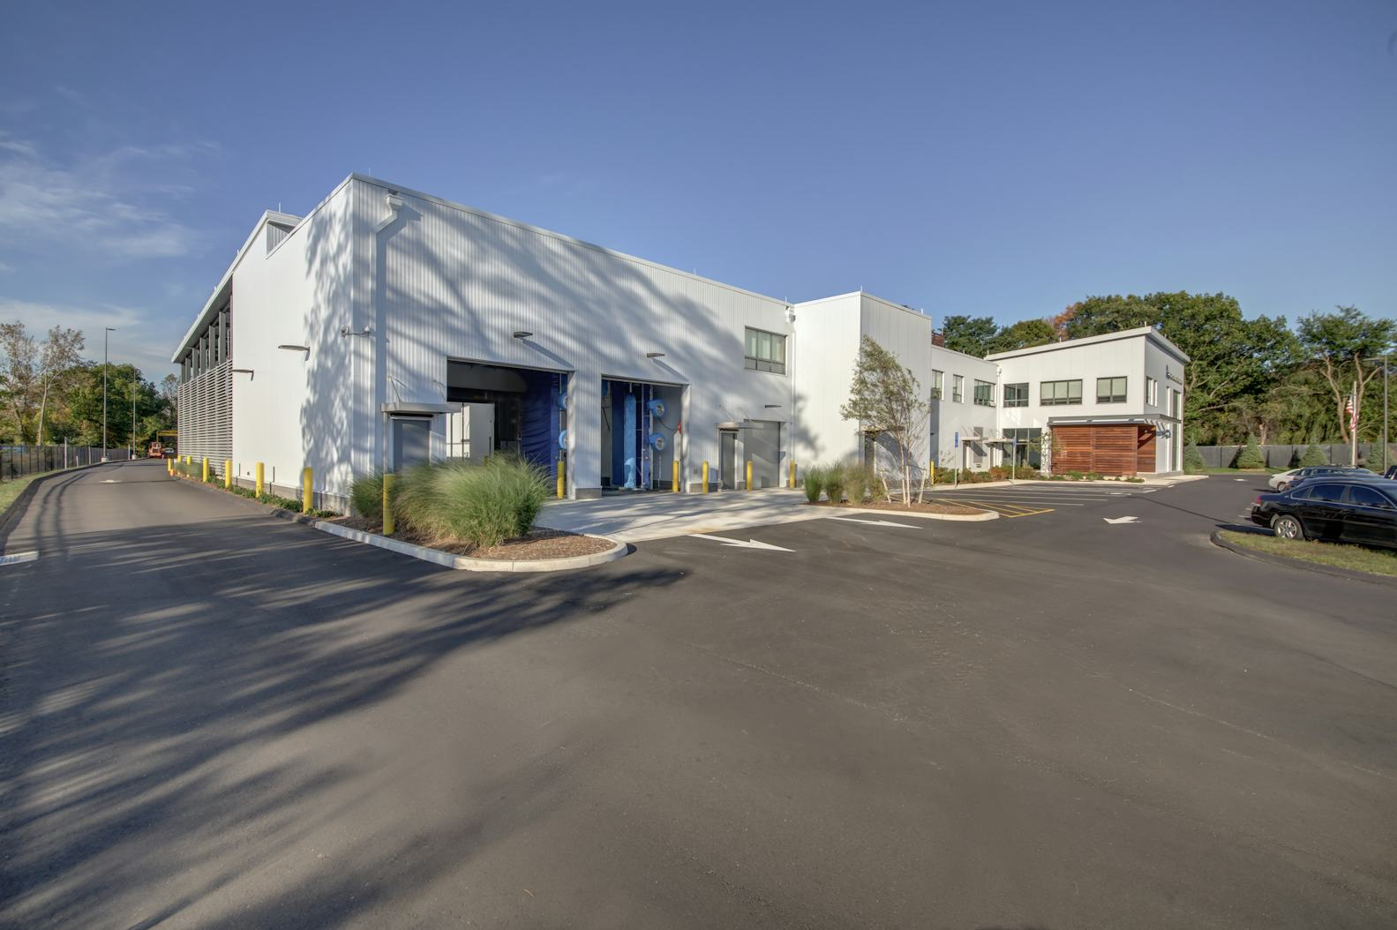
About Greater Hartford Transit District
GHTD Demand Response Services Operations Center – East Hartford
GHTD operates its demand response services from on operations center located in East Hartford. Completed and occupied in 2017, the facility and campus house all operational functions associated with the ADA paratransit service for the Capitol region.
The facility includes administrative space, a training center, a dispatch center, call center, and all maintenance functions. GHTD’s fleet of 180 mini-buses is also stored outside on the site.

Slide 7
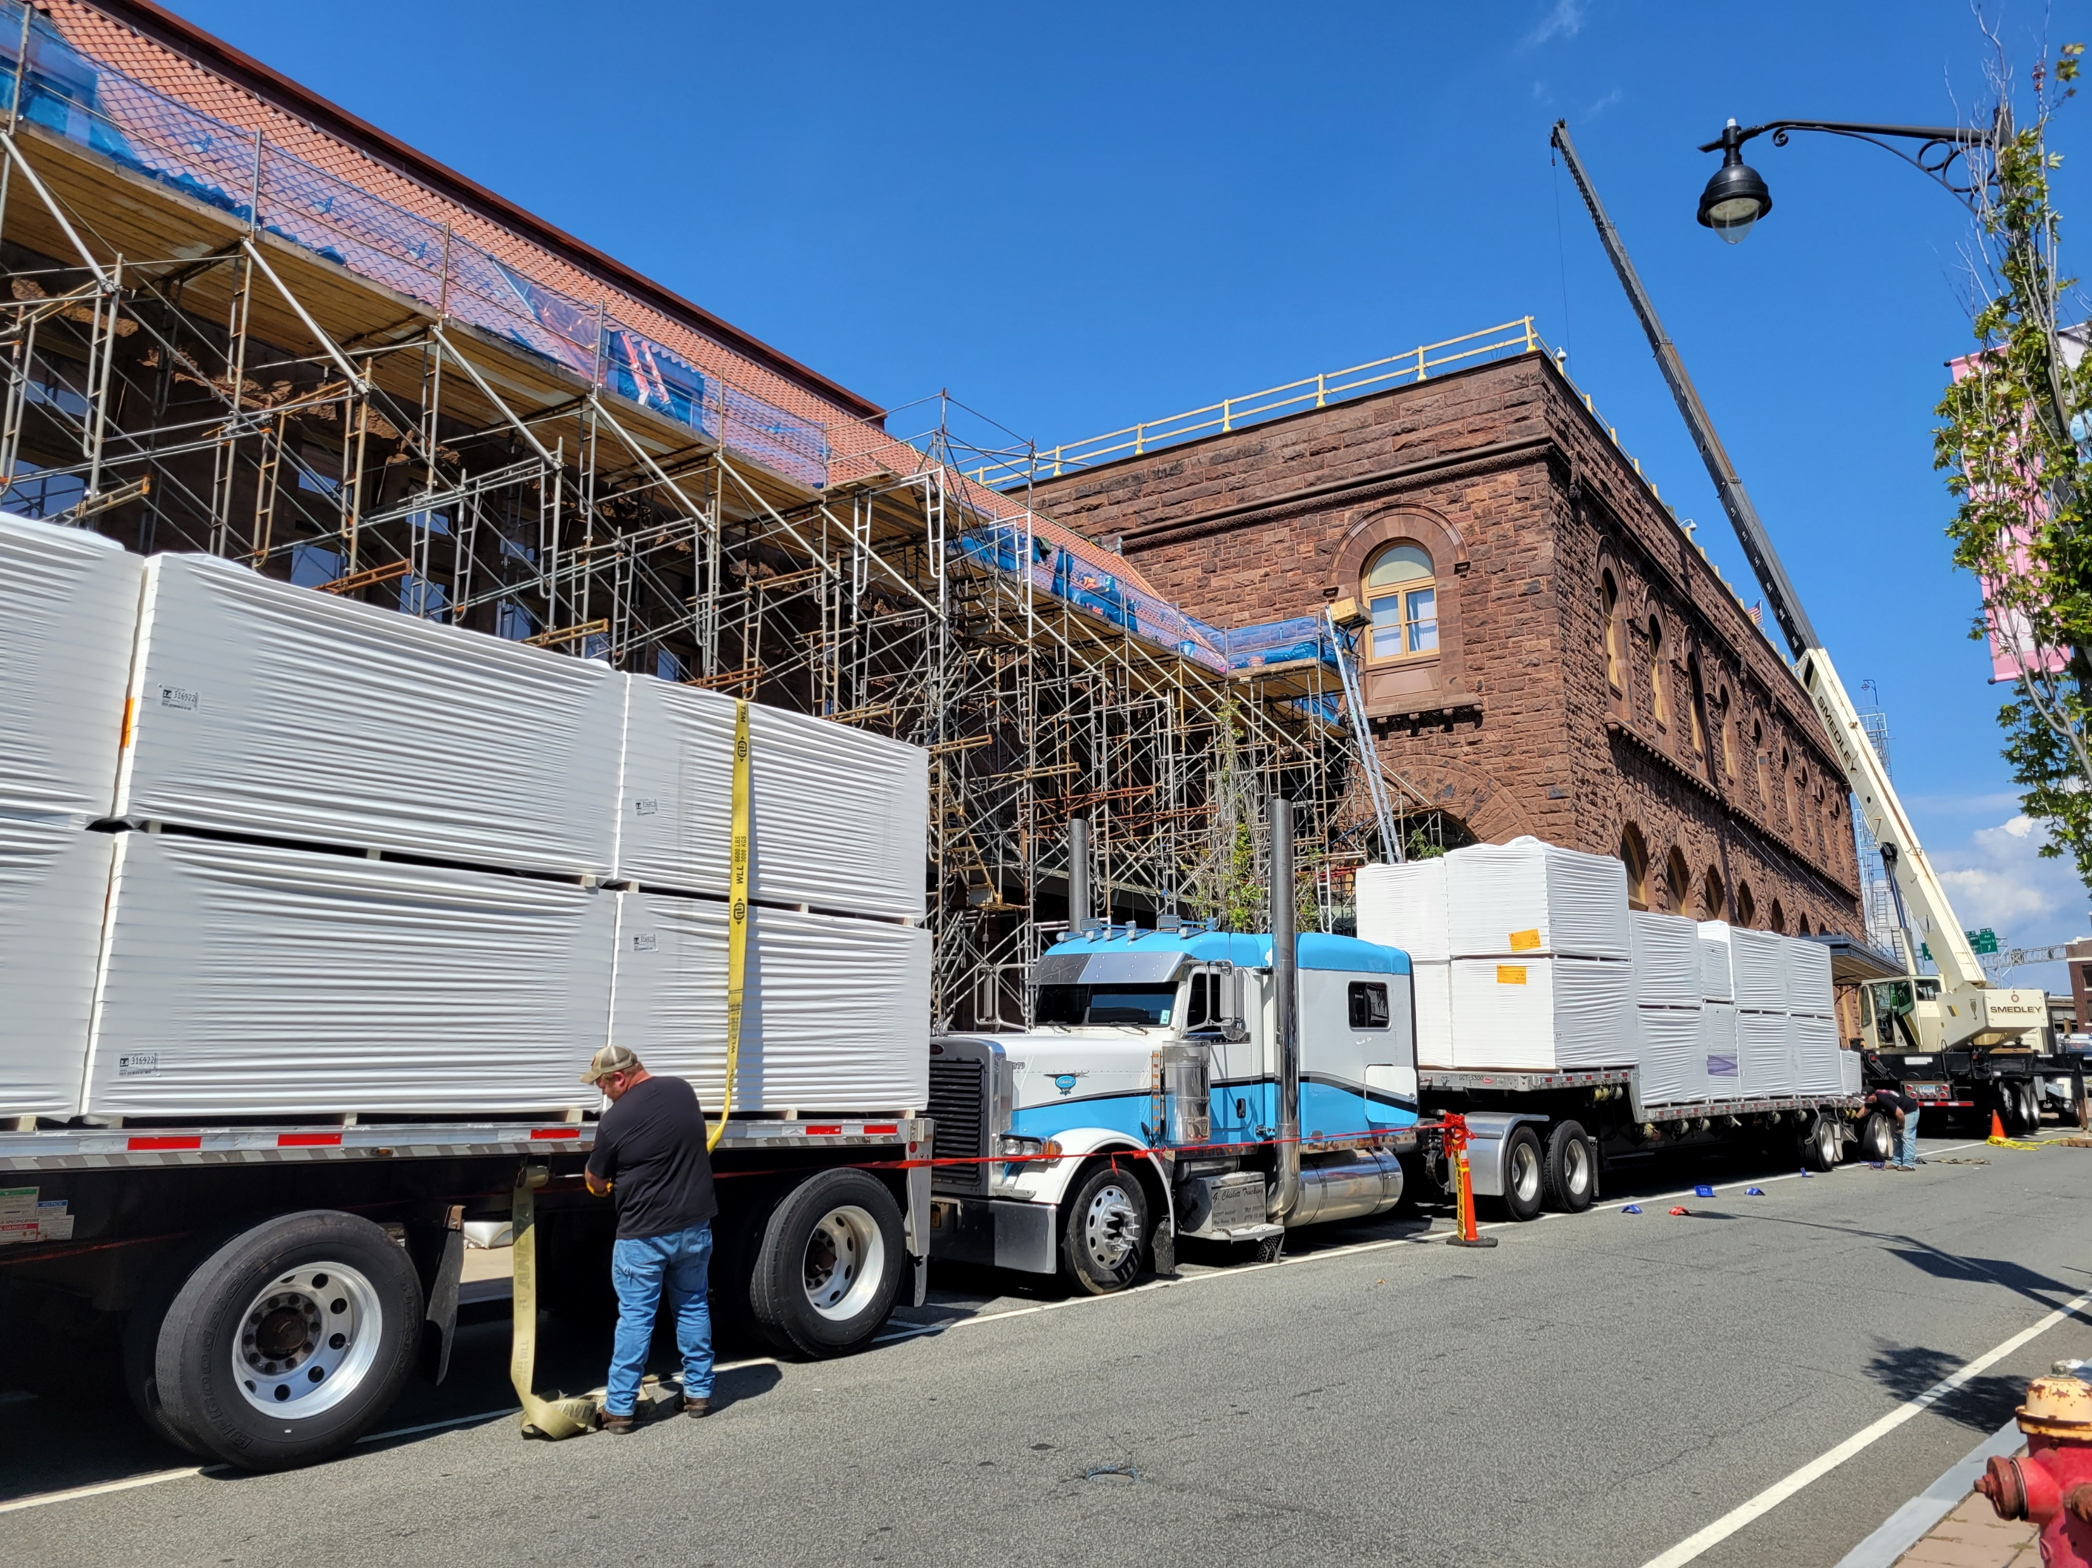
GHTD Planned Projects 2026-2028
Surface Parking Lot Construction
Pavement Repairs Various Locations
Roof Replacement – Transportation Center
HVAC Replacement and Modernization – Union Station
Ongoing Electrical Work
Ongoing Plumbing Work
Ongoing General Repairs/Construction
Architectural and Engineering Services
Website Design
Planning/Consulting Services

Slide 8
Past DBE Goal Attainment
During the most recent period, the goal and attainment were:
It is important to remember that past attainment is not necessarily an indicator of future DBE participation. The goal is established based on the projects that are before GHTD and the relative availability of DBEs to perform the work.
*FY 2025 is incomplete, as the 2nd semi-annual reporting is due December 1, 2025 for the period of 4/1/25-9/31/25.
Period | DBE Goal | DBE Participation | $ Value
FY 2022 | 5.0% | 16.2% | $126,498.00
FY 2023 | 7.9% | 4.1% | $33,551.00
FY 2024 | 7.9% | 9.5% | $348,258.00
FY 2025* | 7.9%* | 44.8%* | $77,321.00 *

Slide 9
GHTD’s Proposed 2026-2028 DBE Goal
7.7 Percent of GHTD Contracting Opportunities;
Worth a total of approximately $908,033;
Achieved through predominantly Race Conscious means monitored/adjusted during the goal period.

Slide 10
Greater Hartford Transit District
Disadvantaged Business Enterprise (DBE)
Triennial Goal Development and Contracting Opportunities
2026-2028
Encouraging DBE Contractor Participation in GHTD Projects

